Slide 1

ERD and Project Scheduling
Classroom Management System
Tasnim Ferdous 180041108
Sidratul Muntaha 180041118
Farhan Ishmam 180041120

Slide 2
Entity Relationship
Diagram
Entity Relationship Diagram, also known as ERD, ER Diagram or ER model, is a type of structural diagram for use in database design. An ERD contains different symbols and connectors that visualize two important information: The major entities within the system scope, and the inter-relationships among these entities.
ERD
02

Slide 3
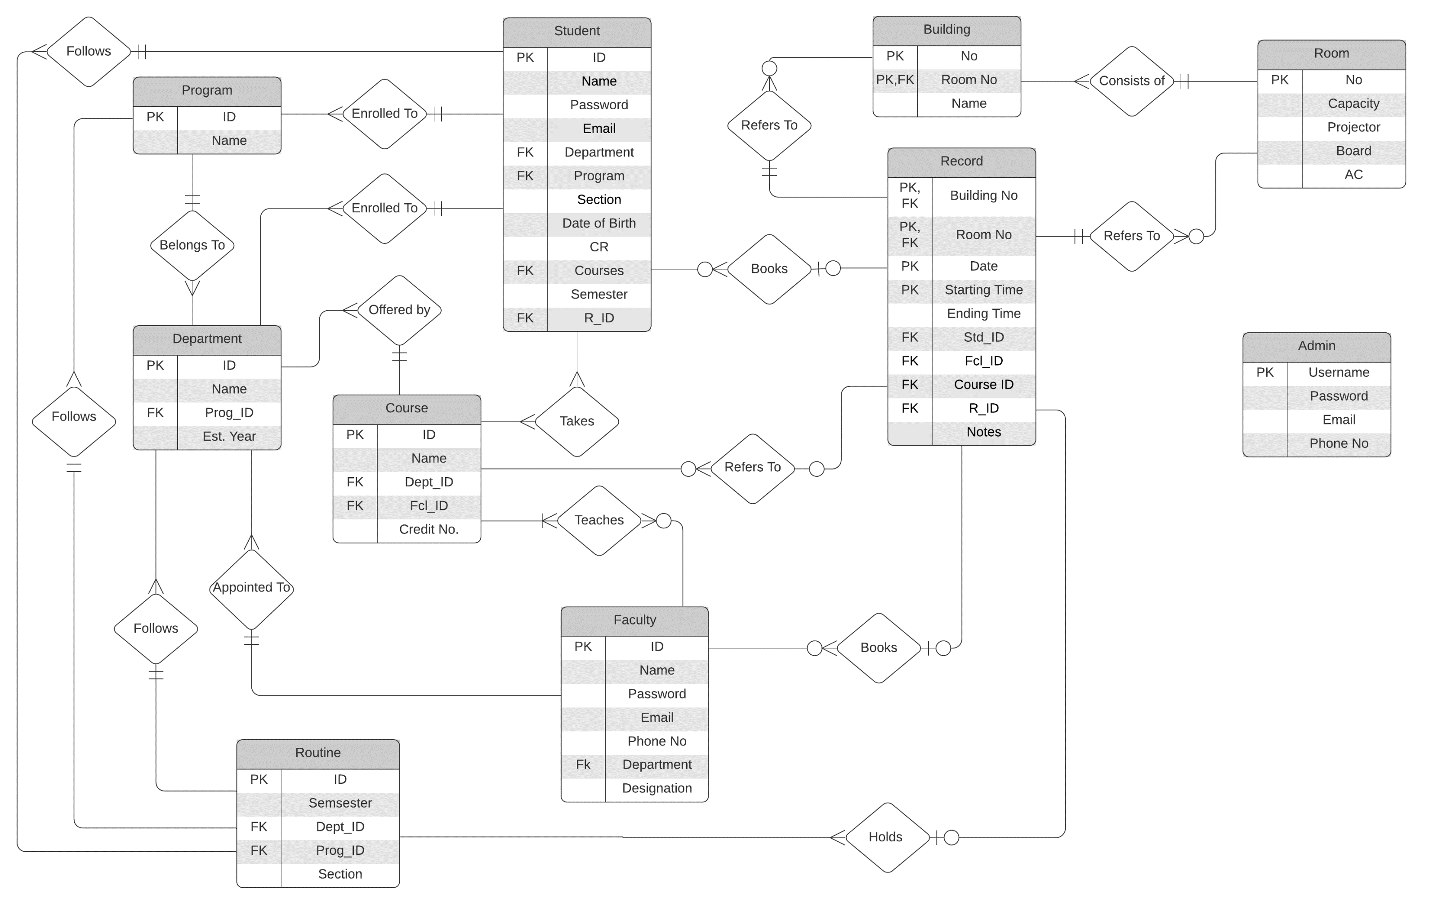
ERD
JANUARY
03

Slide 4
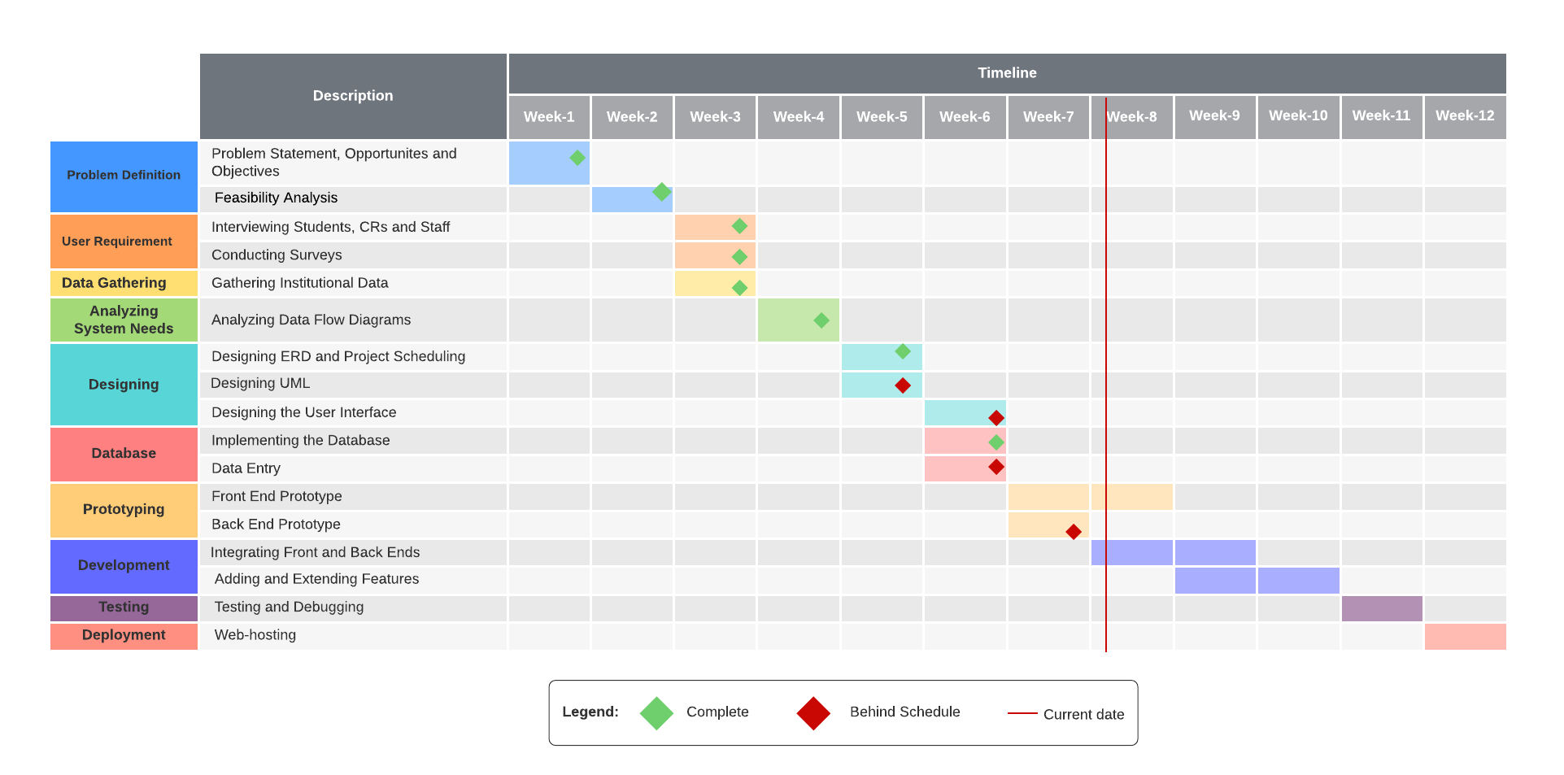
GANTT CHART
JANUARY
04

Slide 5
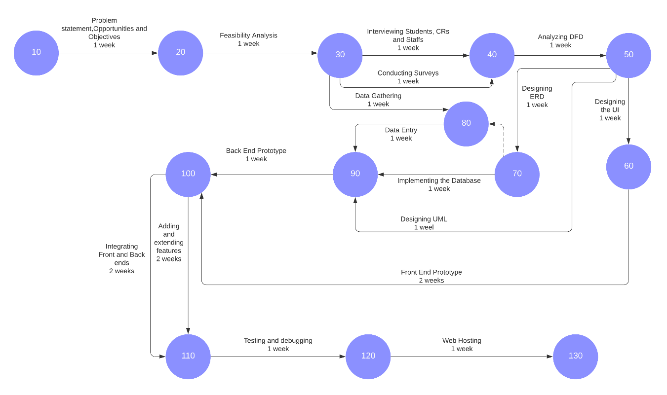
PERT DIAGRAM
05

Slide 6
THANK YOU

